Slide 1

Theoretical Fit
Mykola Chernyashevskyy

Slide 2
Answering Question: Can I include Mb
When Lambda CMD is and why does it say Sigmak is ok.

Slide 3
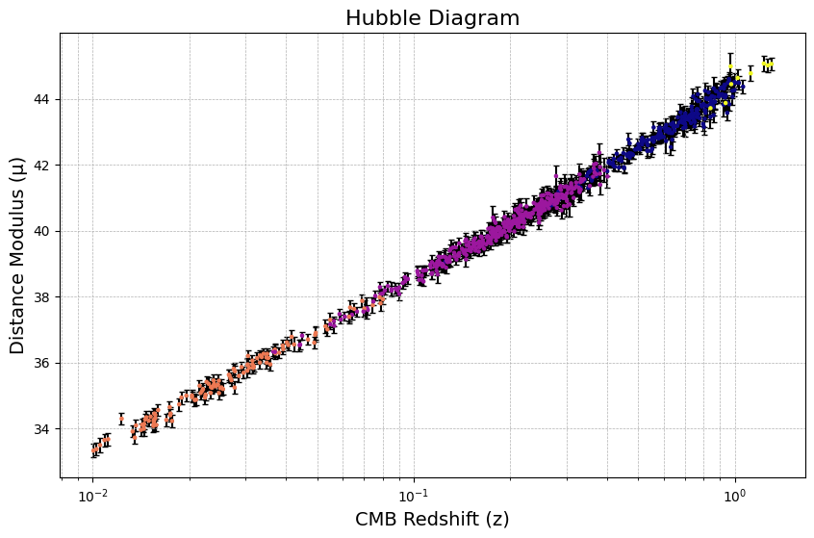
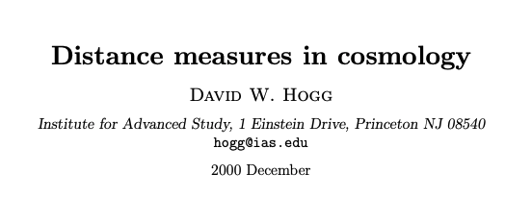
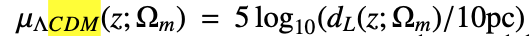
Last Meeting

Slide 4
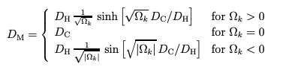
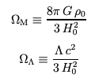
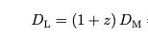
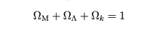
Density Parameters
Curvature of Space

Slide 5
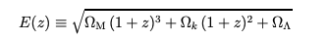
Derivation of the model distance modulus
Given:
d_{L} deriation where it can only be a function of z and SIGMAm:

Slide 6
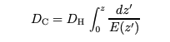
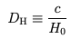
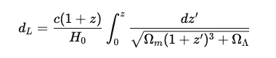
Derivation Cont.

Slide 7
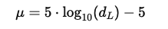
Derivation of the model distance modulus

